Slide 1


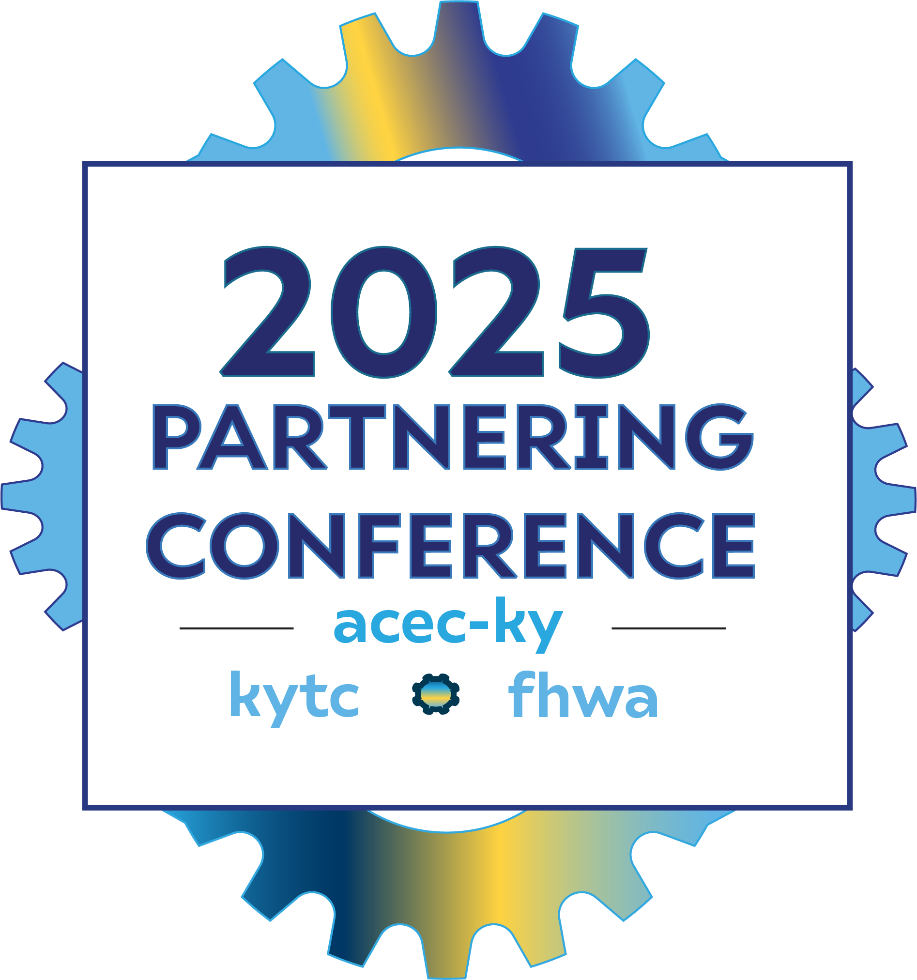
Seeing Red: How Red Flag Studies Keep Projects on Track
By
Karen Mynhier, KYTC
Darrin Eldridge, KYTC
and
Jeff Jasper, KTC

Slide 2

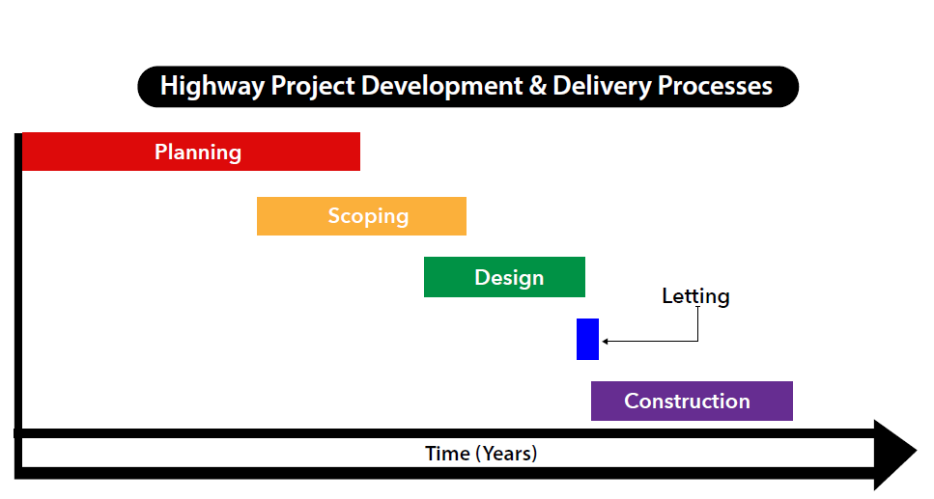
Notes:
In general, every project has a planning process, scoping, design, letting, construction….

Slide 3
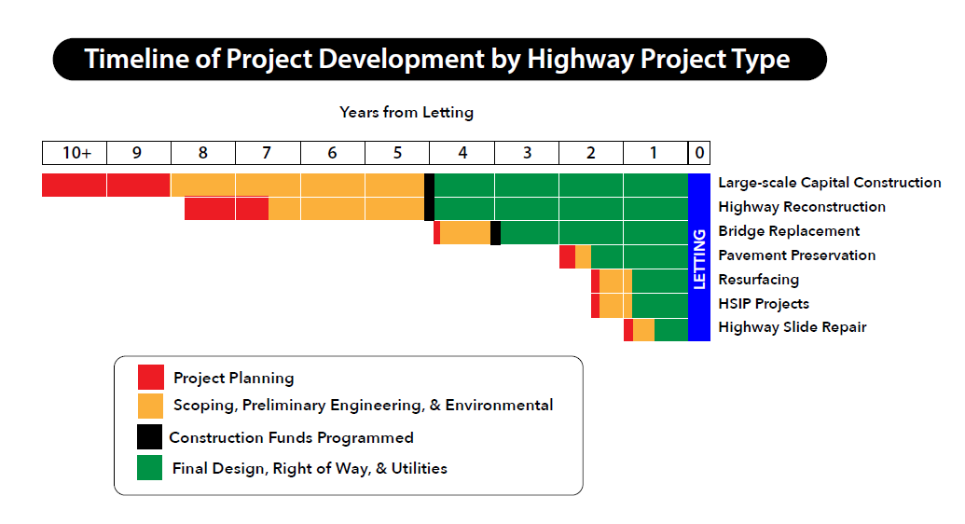
Notes:
EXPLAIN ILLUSTRATION

Slide 4
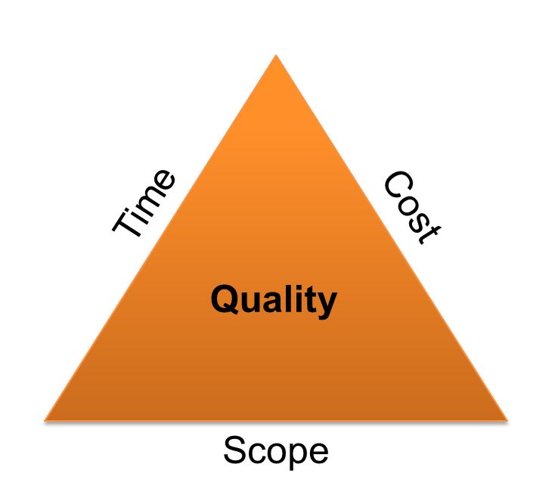
NCHRP Report 821 Effective Project Scoping
  Statistical evidence shows that conducting earlier and more detailed scoping efforts can reduce total design and construction costs by up to 20% and shorten the overall schedule by up to 39%.
Notes:
When a project scope is not clearly defined or uncertain, revisions may take place after the project is already underway, leading to delays or overpromising what can be delivered. Ideally, a reliable, decisive project scope is defined in the early phases of the highway project development process.
[Use the PM Triangle to talk through changes to scope.]
Statistical evidence indicates that earlier and more detailed scoping efforts can reduce total design and construction cost by as much as 20% and shorten total design and construction schedule by as much as 39%.
Ideally, a reliable, decisive project scope is defined in the early phases of the highway project development process. What should we KYTC PMs do if the project scope is uncertain?
If a project requires further definition or its scope needs to be clarified, the PDM should work with the Chief District Engineer (CDE) and Central Office to gain a preliminary understanding of the project purpose and to identify knowledge gaps.

Slide 5
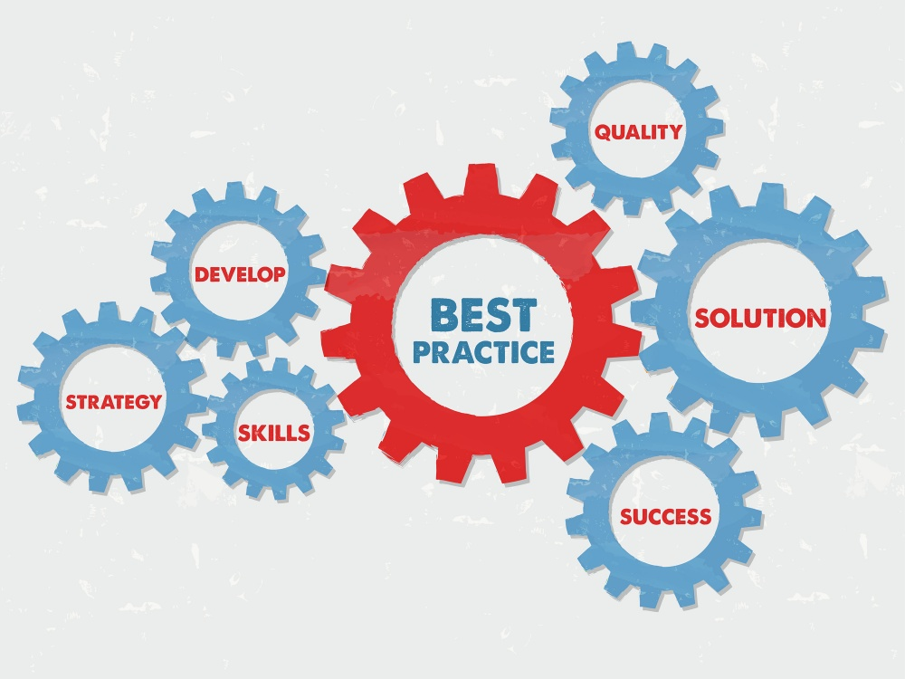
BEST PRACTICES OF PROJECT SCOPING
  Ramp up project development activities during scoping.
Notes:
Initial scoping studies are often done quickly, at a point when the project definition remains uncertain (i.e., project maturity of 0 to 5%). Despite uncertainties associated with these studies, they are often used to program projects in the SYP.
Completing more project development activities during scoping helps to clarify the purpose and need and progress toward a more mature project definition. Advancing project development and scoping in tandem will increase the accuracy of programmed costs. Scoping timeframes should remain flexible and tailored to project needs, but scoping should be completed prior to the start of detailed design.

Slide 6
BEST PRACTICES OF PROJECT SCOPING
  Complete the preliminary project scope with the input of a multidisciplinary team.
Notes:
Using multidisciplinary teams for scoping enables better risk identification and improved estimates of the amount of time and expense required to address risks. Adopting a multidisciplinary approach to scoping and dedicating more resources to projects during their early stages also strengthens the ties between scoping and other facets of project development. More clearly defining project attributes, risks, schedules, and cost estimates improves project delivery and program predictability.
Hold a pre-planning conference to help define the project, identify needed experts, and begin developing the purpose and need.
Ask SMEs to identify issues that could impact the scope. Use their findings when estimating project costs and schedules.

Slide 7
BEST PRACTICES OF PROJECT SCOPING
  Develop risk analyses for more complex projects.
Notes:
Develop risk analyses for more complex projects. Identify potential challenges and determine appropriate time and money contingencies.
Retain consultants where necessary for planning and scoping. Involve construction experts in scoping to address constructability issues.

Slide 8

“Normal” Rural Federal Bridge Replacement CE
Notes:
This is a process map for rural federal bridge replacement – our “simplest” highway project. Don’t worry about reading what is in the blocks; that’s not the point. Each block is a process in project development. Gray boxes are milestones. Black diamonds are decision point.

Slide 9
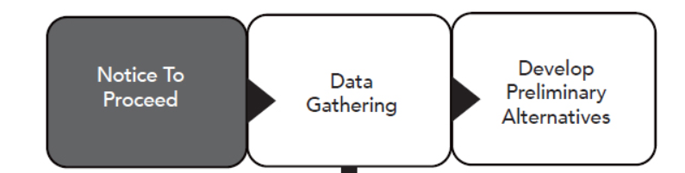
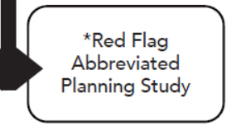
Data Gathering Activity

Slide 10
The goal of a Red Flag Study is to identify significant existing features early in a project.
Notes:
If these features remain unknown and are impacted by the project, KYTC may incur expenses and/or delays that could have been prevented.

Slide 11
What happens if a significant existing feature is not identified early in a project?
Notes:
If these features remain unknown and are impacted by the project, KYTC may incur expenses and/or delays that could have been prevented.

Slide 12
Planning
Program Management
Professional Services
Environmental Analysis
Highway Design
Structure Design & Geotechnical
Traffic Operations
Utilities & Rail
Right of Way
Legal
Construction Procurement
Construction
Maintenance
Notes:
An abbreviated Planning/Red flag study may require planning prequalification. The consultant should be prepared to have these services available. The consultant project engineer should work with the PM to ensure that the studies provide early project direction.
Because of the information received from the Planning/Red Flag studies and phase 1 geotechnical and structural investigations, PM’s may request fewer alternative alignment studies in lieu of more specific and technical alignment reviews.
Environmental High Risk Items, A Red Flag Study could identify these items so that they may be avoided or minimized prior to the development of alternatives.

Slide 13
From Theory → To Practice
Karen Mynhier, KYTC
Darrin Eldridge, KYTC

Slide 14
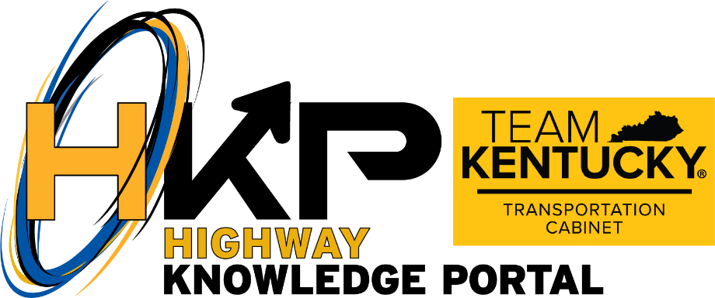




Project Management Guidebook
HKP: Project Initiation
HKP: Project Identification
HKP: Project Scoping
Notes:
KYTC’s Project Management Guidebook (PMGB) defines a common approach for application of project management techniques that can be applied to all KYTC highway projects through the project development process – which is normally the preconstruction stage of a project from the planning report to the project letting. Effective management is achieved by combining Project Management tools/techniques with sound application of project management principles.

